Slide 1
Foundations of the Semantic Web
Lecture 4
More Pattern and a Problem
Classes as Values
Combining Necessary & Sufficient with Necessary conditions (General Inclusion Axioms - GICs)
Alan Rector

Slide 2
Part 1: Classes as Values
In OWL DL nothing can be both a class and an individual
  In classic Protégé and most frame languages everything is an individual of something
    The class MetaClass is an instance of itself.
  In OWL-Full a class can also be an individual
Why the problem?
  Paradoxes of self reference - undecidable statements are hard to avoid
    Russell Paradox: The class of all classes that are not instances of themselves.
    Liar Paradox (Epimenides paradox): Is the following statement true? “This statement is false”
The logic is trickier than it looks
  If you are interested in the theory look up Zermelo Frankel and/or Von Neuman set theory - or talk to our logician colleagues

Slide 3
The classic application
I want to index book / web pages / films … according to what they are ‘about’.
The standard vocabulary for doing this in rdf is “Dublin Core” - namespace usually abbreviated to “dc:”

Slide 4
Using Classes as Property Values
dc:subject
Animal
Lion
Tiger
subject
African
Lion

Slide 5
Using Classes Directly As Values
Animal
BookAboutAnimals
rdfs:subclassOf
Lion
rdf:type
dc:subject
"Lions:
Life in the Pride"
rdf:type
rdfs:subclassOf
African
Lion
dc:subject
”The African
Lion"

Slide 6
Cannot do this directly in OWL 1.0
Will use ‘puns’s as weak solution in OWL 1.1
Best approximation in existing protégé
  Name a an individual for each class with a suffix or naming-convention, e.g. lower case.
  Provide the mirroring relation by hand or script
There should be improved solutions coming

Slide 7
Approach 1: Considerations
Compatible with OWL Full and RDF Schema
Outside OWL DL
  Because classes cannot be values in OWL-DL
    Nothing can be both a class and and instance

Slide 8
Approach 2: Hierarchy of Subjects
Animal
BookAboutAnimals
rdfs:subclassOf
rdf:type
Lion
rdf:type
"Lions:
Life in the Pride"
rdfs:subclassOf
dc:subject
”The African
Lion"
rdf:type
African
Lion
LionSubject
dc:subject
rdf:type
AfricanLionSubject

Slide 9
Hierarchy of Subjects: Considerations
Compatible with OWL DL
Instances of class Lion are now subjects
No direct relation between
LionSubject and AfricalLionSubject
Maintenance penalty
Lion
rdf:type
rdfs:subclassOf
LionSubject
African
Lion
rdf:type
AfricanLionSubject

Slide 10
Hierarchy of Subjects
Animal
Subject
BookAboutAnimals
rdfs:subclassOf
rdf:type
Lion
rdf:type
"Lions:
Life in the Pride"
rdfs:seeAlso
rdf:type
rdfs:subclassOf
dc:subject
African
Lion
LionSubject
”The African
Lion"
rdf:type
parentSubject
rdfs:seeAlso
dc:subject
AfricanLionSubject

Slide 11
Hierarchy of Subjects: Considerations
Compatible with OWL DL
Subject hierarchy (terminology) is independent of class hierarchy (rdfs:seeAlso)
Maintenance penalty
Lion
Subject
rdf:type
rdfs:subclassOf
African
Lion
LionSubject
rdfs:seeAlso
parentSubject
AfricanLionSubject

Slide 12
Apporach 3. Using members of a class as values
Animal
BookAboutAnimals
rdfs:subclassOf
rdf:type
Lion
"Lions:
Life in the Pride"
rdf:type
rdfs:subclassOf
rdf:type
dc:subject
African
Lion
some
Unidentified Lion(s)
”The African
Lion"
rdf:type
dc:subject
some Unidentified
African Lion(s)

Slide 13
Protégé Examples of Approaches 2-3

Slide 14
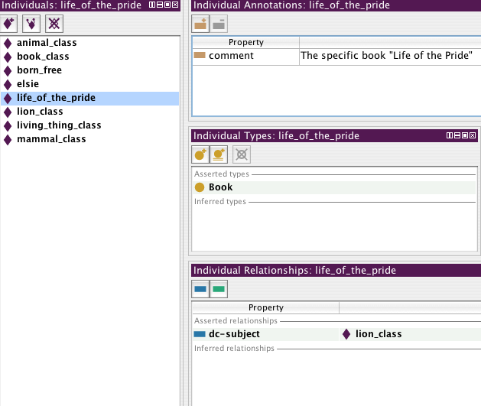
Representation in Protégé

Slide 15
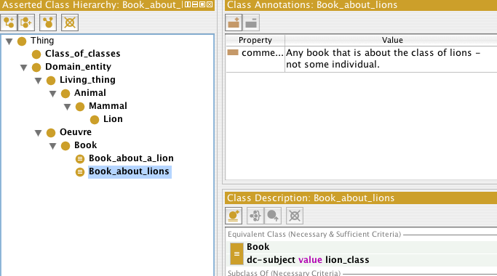
Class Hierarchy: Book about Lions

Slide 16
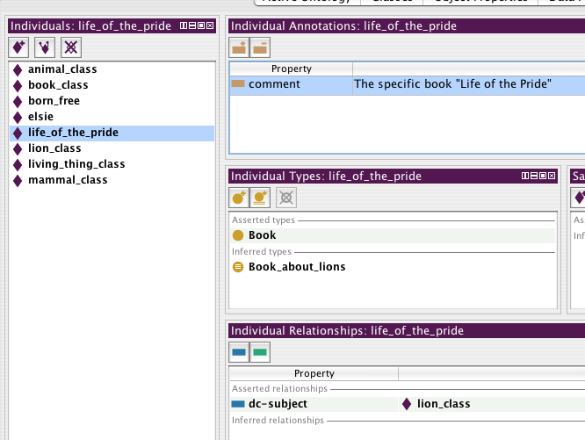
Inference

Slide 17
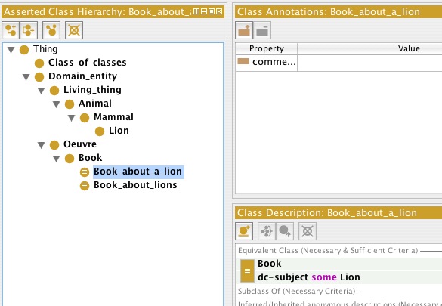
Book about SOME Lion

Slide 18
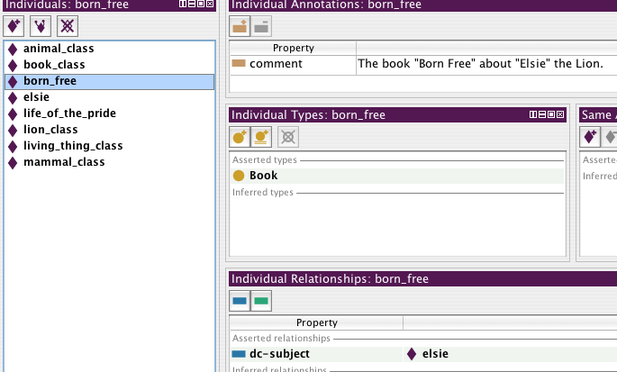
A Book about a Lion “Born Free”

Slide 19
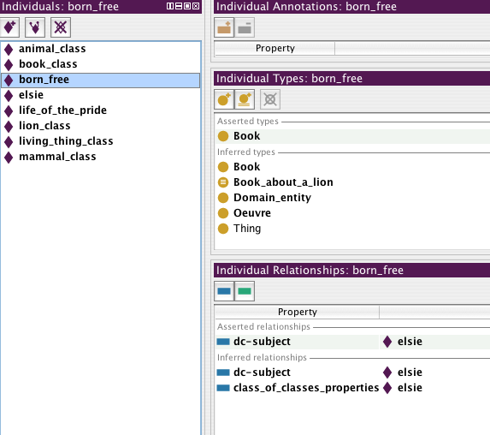
Inference

Slide 20
Considerations
Compatible with OWL DL
Interpretation: the subject is one or more specific lions, rather than the Lion class
Can use a DL reasoner to classify specific books
Manchester’s preferred solution
  … but others disagree

Slide 21
Part 2 Defined Classes with Necessary Conditions
OWL allows the same class to be defined and have additional necessary conditions
  Protégé OWL has made this easy to do

Slide 22
Defined classes with necessary conditions
What does it mean to have both kinds of restrictions
  Necessary and Sufficient
  Necessary
Animal_with_fins =
Animal AND has_limb_type Fins
==>
habitat_includes someValuesFrom Aquatic_habitat
Vocabulary: “Aquatic” - having to do with water.

Slide 23
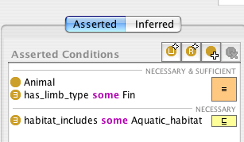
Defined classes with necessary conditions
Effectively such classes are rules or axioms
  “Any animal with fins, has a habitat that includes includes some Aquatic_habitat”

Slide 24
SubclassOf means “Necessarily implies”
Protégé OWL necessary statements necessary implications
  Equivalent to subclass axioms
    In fact the interface will move the class under the subclass
Very strong statement
  Any animal, without exception, that has fins lives in aquatic habitat
    Think about Toads - do their habitats include aquatic?
      The properties were phrased carefully
Therefore defined classes with necessary statements are called “General Inclusion Axioms”
  They are a general way of writing axioms about subsumption (“inclusion”)

Slide 25
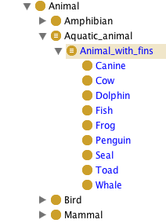
Subsumption means necessary implication - the classifier produces

Slide 26
Debugging & GICs
If a definition implies that something is classified under it that conflicts with its necessary conditions
  The classifier will not show the classification
    It will just show that the class is unsatisfiable but will not move it.
  Therefore, although powerful, such constructs can be hard to debug

Slide 27
Part 3:
A Ridiculously Brief Glance at
Representing Time & Space

Slide 28
Extents, Intervals, and Ordering
“Extent” is a general term for a point, interval, area, volume, etc. in space and/or time
Time comes with natural coordinates
  Many spatial measures are also laid out with coordinates
Timed is concerned with points and interval
Space with points, intervals, areas, and volumes
Most temporal and spatial reasoning beyond OWL

Slide 29
A few things you should know
Axioms of Ordering of time or lines
For points in an ordered one-dimensional space
  Anti-symmetry
    X<Y → ¬(Y<X)
  Transitivity
    X<Y & Y<Z → X<Z
  Totality
    X<Y ∨ Y<X ∨ X=Y

Slide 30
For an Ordered One Dimensional Space
Relations between Intervals
The “Allen Calculus” specifies the
results of combining intervals.
There are precisely 13 possible combinations
including symmetries (6 * 2 + 1)

Slide 31
Exercise
Using the diagrams on the previous slide,
write down the axioms that should apply to the relations between intervals
  r1(X,Y) & r2(Y,Z) → r?(X,Z)
    e.g.
    before(X,Y) & before(Y,Z) → before(X,Z)

Slide 32
Points and Intervals
Time representations are either point based or interval based
  A point can be viewed as:
    An interval of zero length
    One of the set of ordered things that make up an interval.
  Points can be:
    Contained in intervals
    The start or end of the interval
      start(I) or end(I)

Slide 33
Classic Situation Calculus
Time, Situations, and Fluents
Situation = a cross section of time
Representation as parameter
  “The radio was on at 9:00”
  on(radio, S9:00)
Representation by fluents (things that can be true in situations)
  “the radio was on at 9:00”
  true_in(s9:00, on(radio))

Slide 34
Basic Assumptions
There is an integral measure clock time
  The differential measure of clock time is duration
Intervals of clock times are sets of clock times
  “Kenedy was president throughout 1962”
  S ∈ year_1962 ↔ kennedy=value_in(S, president(us))
  Intervals of clock times have durations

Slide 35
Events, States and Fluents
Fluents refer to time points and may be of three types:
  Things that can have values - states
    NB “state” is used differently by other authors!
  Things that can occur - events
  Things that change things - processes
    Davis defines processes as a special case of state which can be active or inactive

Slide 36
Processes and Events
Alternative View
Processes have duration and correspond to intervals and have positive duration.
Events correspond to points and have zero duration.
States have values and may hold those values and have a duration but the duration may be zero.
  In most ontologies states must correspond to intervals, though the intervals may be of zero length.

Slide 37
What is an event? A process?
He sat down at three o’clock sharp.
He sat down slowly and carefully.
He was so stiff that it took him nearly a half a minute to sit down
He sat down before the meeting.
The birthday party took place on Tuesday
The birthday party lasted three hours.
The birthday party was the biggest event of the season

Slide 38
Situations and OWL/DLs
Full situation calculus beyond OWL or DLs
  and even to attempt it need concrete data types
Can use the idea of a situation
  If using an event-based view of time
    The class of situations in which someone is sitting down at 18:00
    Sitting_at_1800 ⬇
    Situation and
    (hasFluent someValuesFrom SittingProcess ) and
    (occursAt someValuesFrom
    (Event and occursAt value 1800)))

Slide 39
Situations and OWL/DLs (cont)
  if using an interval based view of time
    Sitting_between_1800_and_1801 ≡ Situation and
    (hasFluent someValuesFrom SittingProcess) and
    (occurs_during someValuesFrom
    (Interval and (hasStartTime value 1800)
    and (hasEndTime value 1801)))

Slide 40
Snaps and Spans 3D and 4D views
Yet another View
Another version is to index by time
  A “span” is entire history of an entity through time
    Spans are intrinsically four dimensional
  A “snap” is a cross section of a span at a point in time.
    Qualities of continuants are dependent on the SNAP and change in the course of a SPAN
      e.g. an Apple can be green in one SNAP and red in a later SNAP
  A “situation” is a piece of situated information in a 4-D universe; a “Snap” is a three D section of a 4 d entity
Due to Barry Smith et al
(google “Barry Smith”)

Slide 41
single-cell zygote
multi-cell zygote
morula
early blastocyst
gastrula
new born
infant
adolescent
young adult

Slide 42
The Future of Time in OWL
Might also represent ordering of time or intervals, but
  most useful applications require both concrete domains and individuals
  highly speculative at this time
  but description logics are closely related to formally to temporal logics, so …

